Slide 1

RUMYPET(R U my pet?)
Final Demonstration
Team Groza
Kim Tae Hong (20132335)
Kim Chan Il (20150577)
Paeng Jin Wook (20154645)

Slide 2

Contents
Introduction
Project Construction
Development Progress
Execution Result
Problem & Future

Slide 3

1. INTRODUCTION

Slide 4
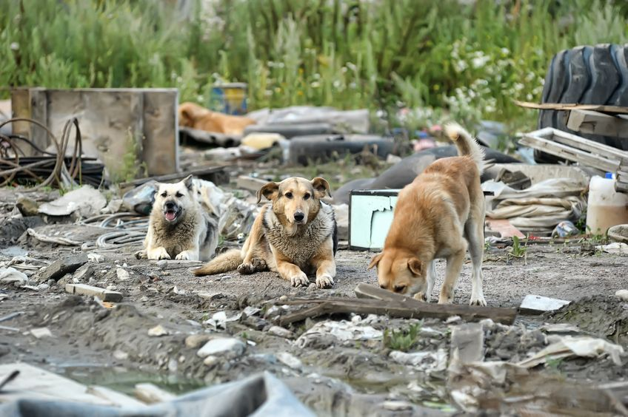
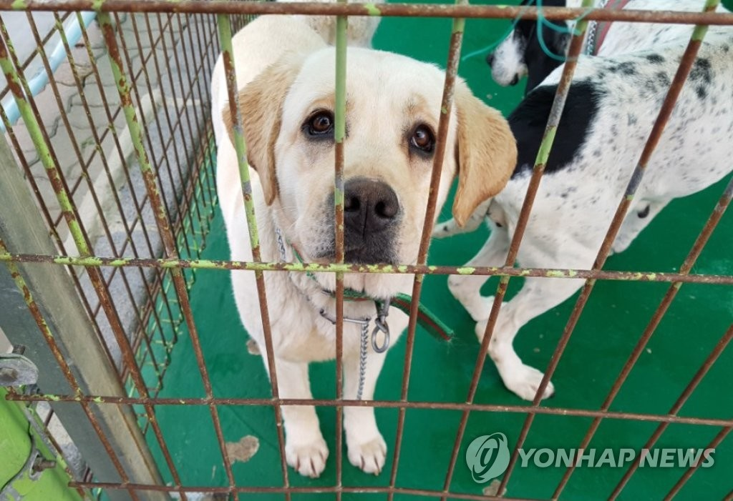
According to the statistics of ‘Animal and Plant Quarantine Agency’,
245 pet animals were abandoned on a daily basis in South Korea.
In Total, about 90,000 animals are abandoned or went missing last year.
And only 15.2 percent of the stray animals were able to return to their owner
Please find my Owner
:(
4
Notes:
Or we can apply it to many other parts.

Slide 5
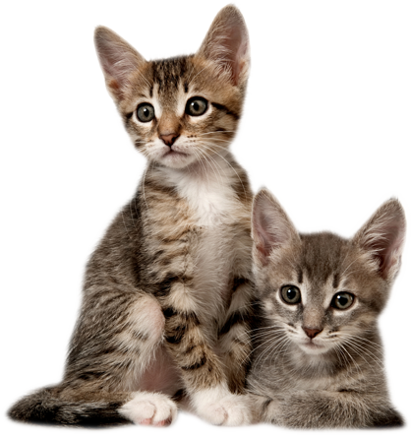
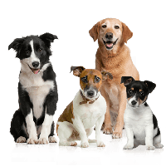
In Animal type, Dogs account for 70.9% of all abandoned pet
4
Notes:
Or we can apply it to many other parts.

Slide 6
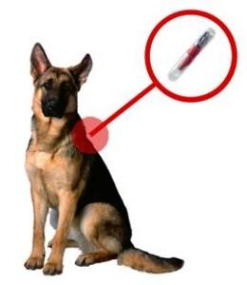
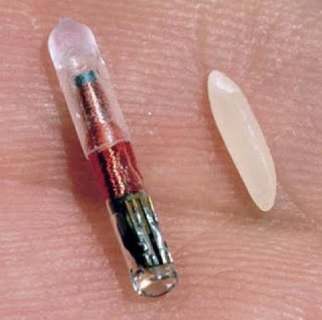
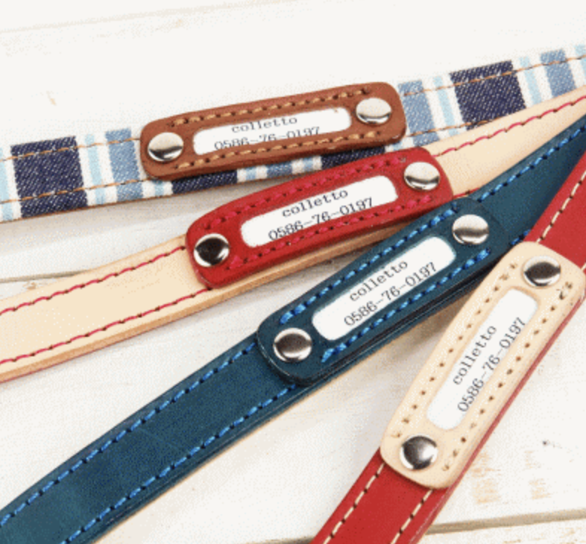
These days, some of the Vet
recommend to implant the Micro Chip in the pet’s body,
But most of the owner don’t want their pet to be implanted.
And the Dog Necklace can be disappear easily,
and some dogs may don’t like it
4
Notes:
Or we can apply it to many other parts.

Slide 7
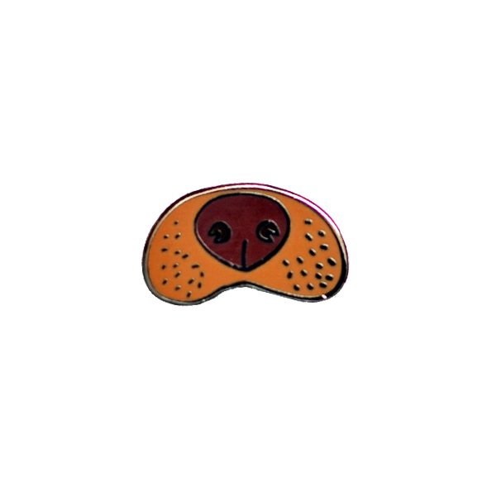

Then we found out that
Dog’s Nose shape is different for each dogs
Same Principle with fingerprint in human side.
4
Notes:
Or we can apply it to many other parts.

Slide 8



RUMYPET (Are you my pet?)
RUMYPET is a Mobile Application (Android)
that can register Identification of the dog
by taking a picture of their nose.
4
Notes:
Or we can apply it to many other parts.

Slide 9


Using this Application, we can find the lost dog’s owner.
And maybe it can be used in many ways related to the dog’s identification
4
Notes:
Or we can apply it to many other parts.

Slide 10
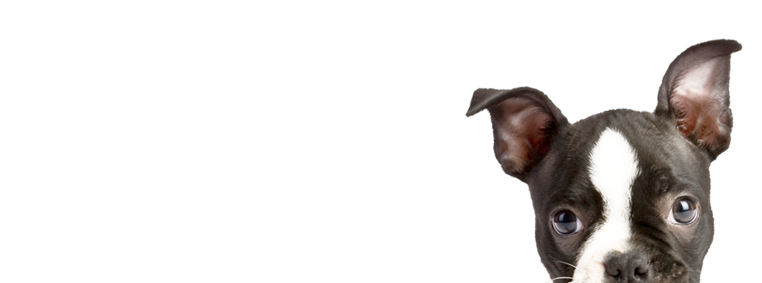
2. Project Construction

Slide 11
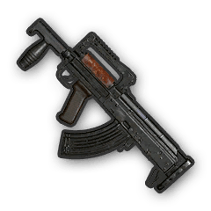
We are team Groza
5

Slide 12

Our team is consist of three people
5

Slide 13
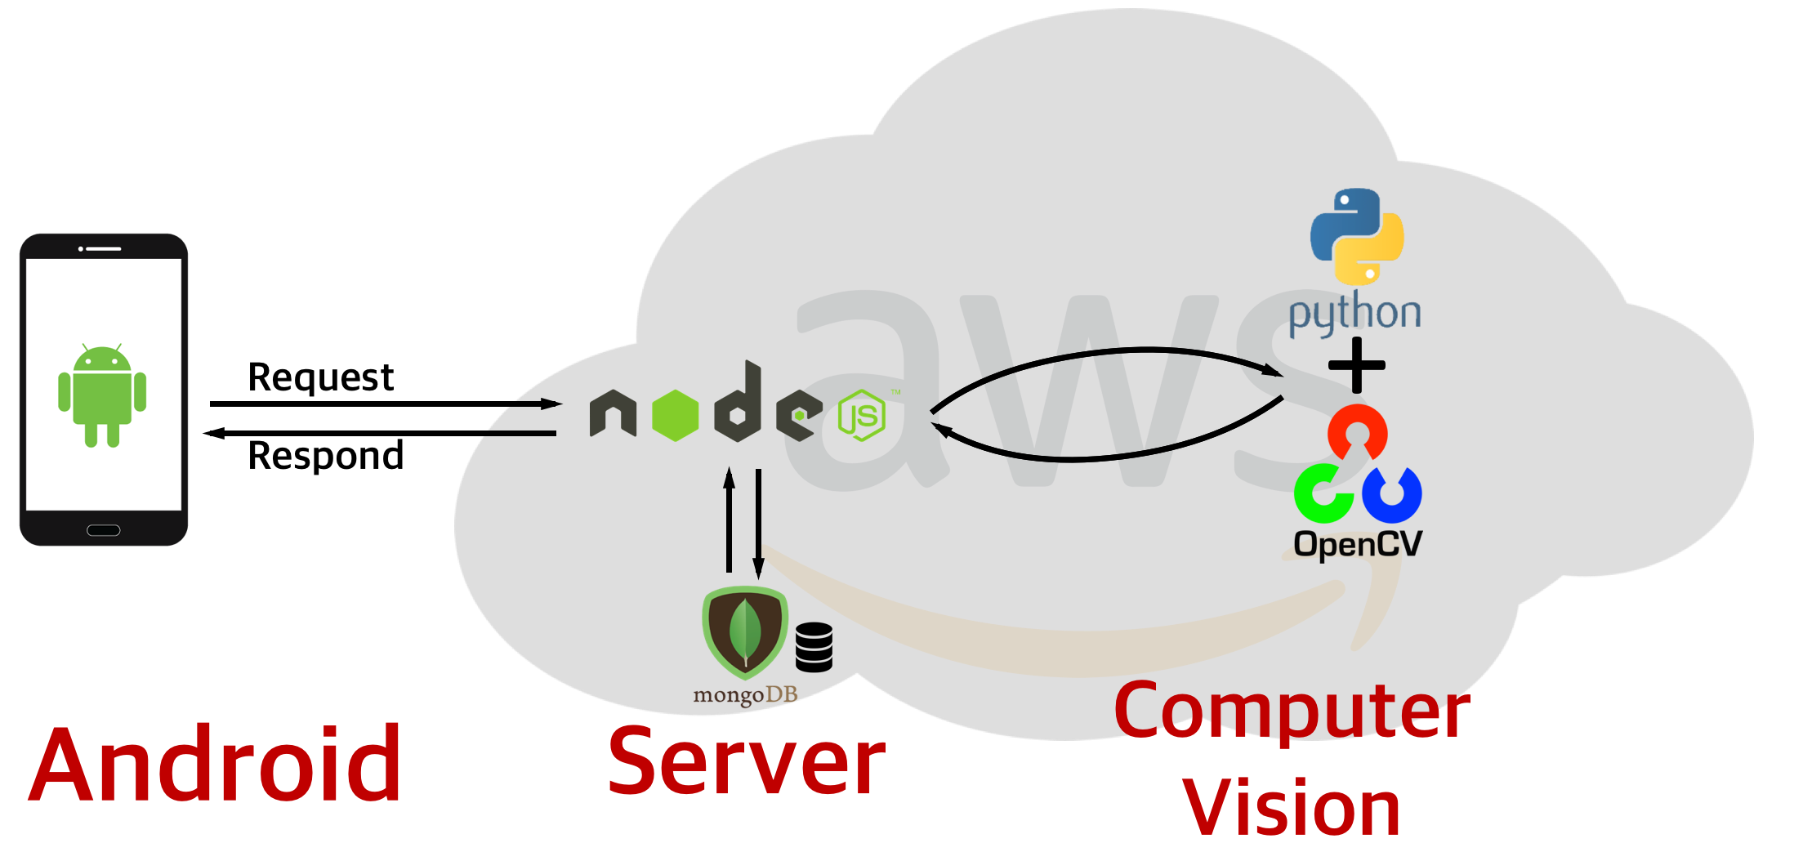
So we divide our job into 3 Parts
5

Slide 14

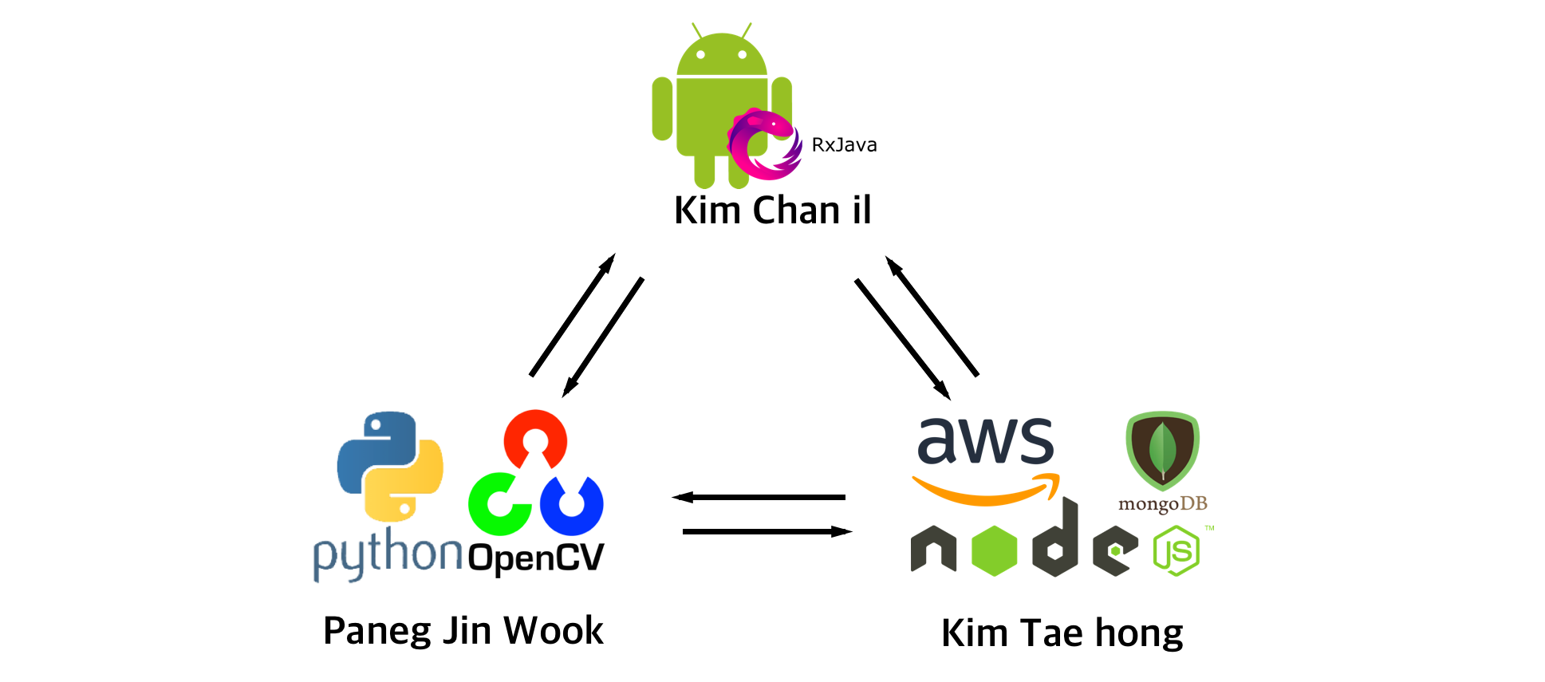
https://github.com/GrozaTeam/Rumypet
5

Slide 15
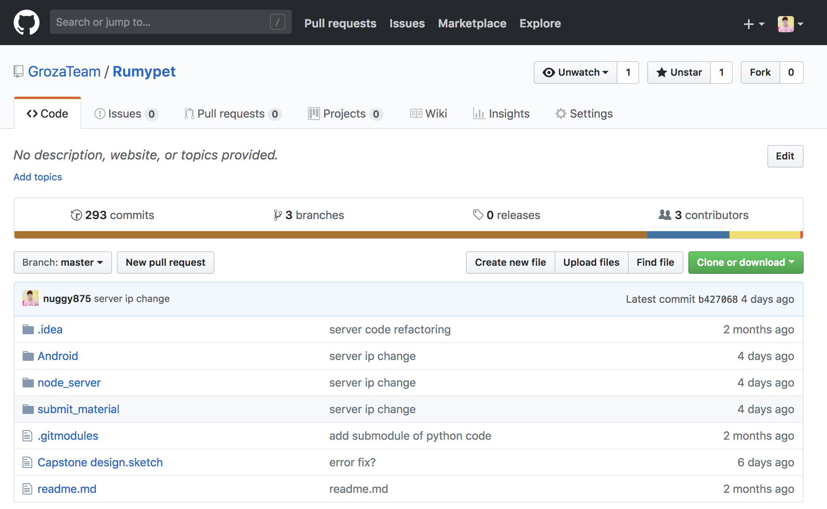
https://github.com/GrozaTeam/Rumypet
5

Slide 16
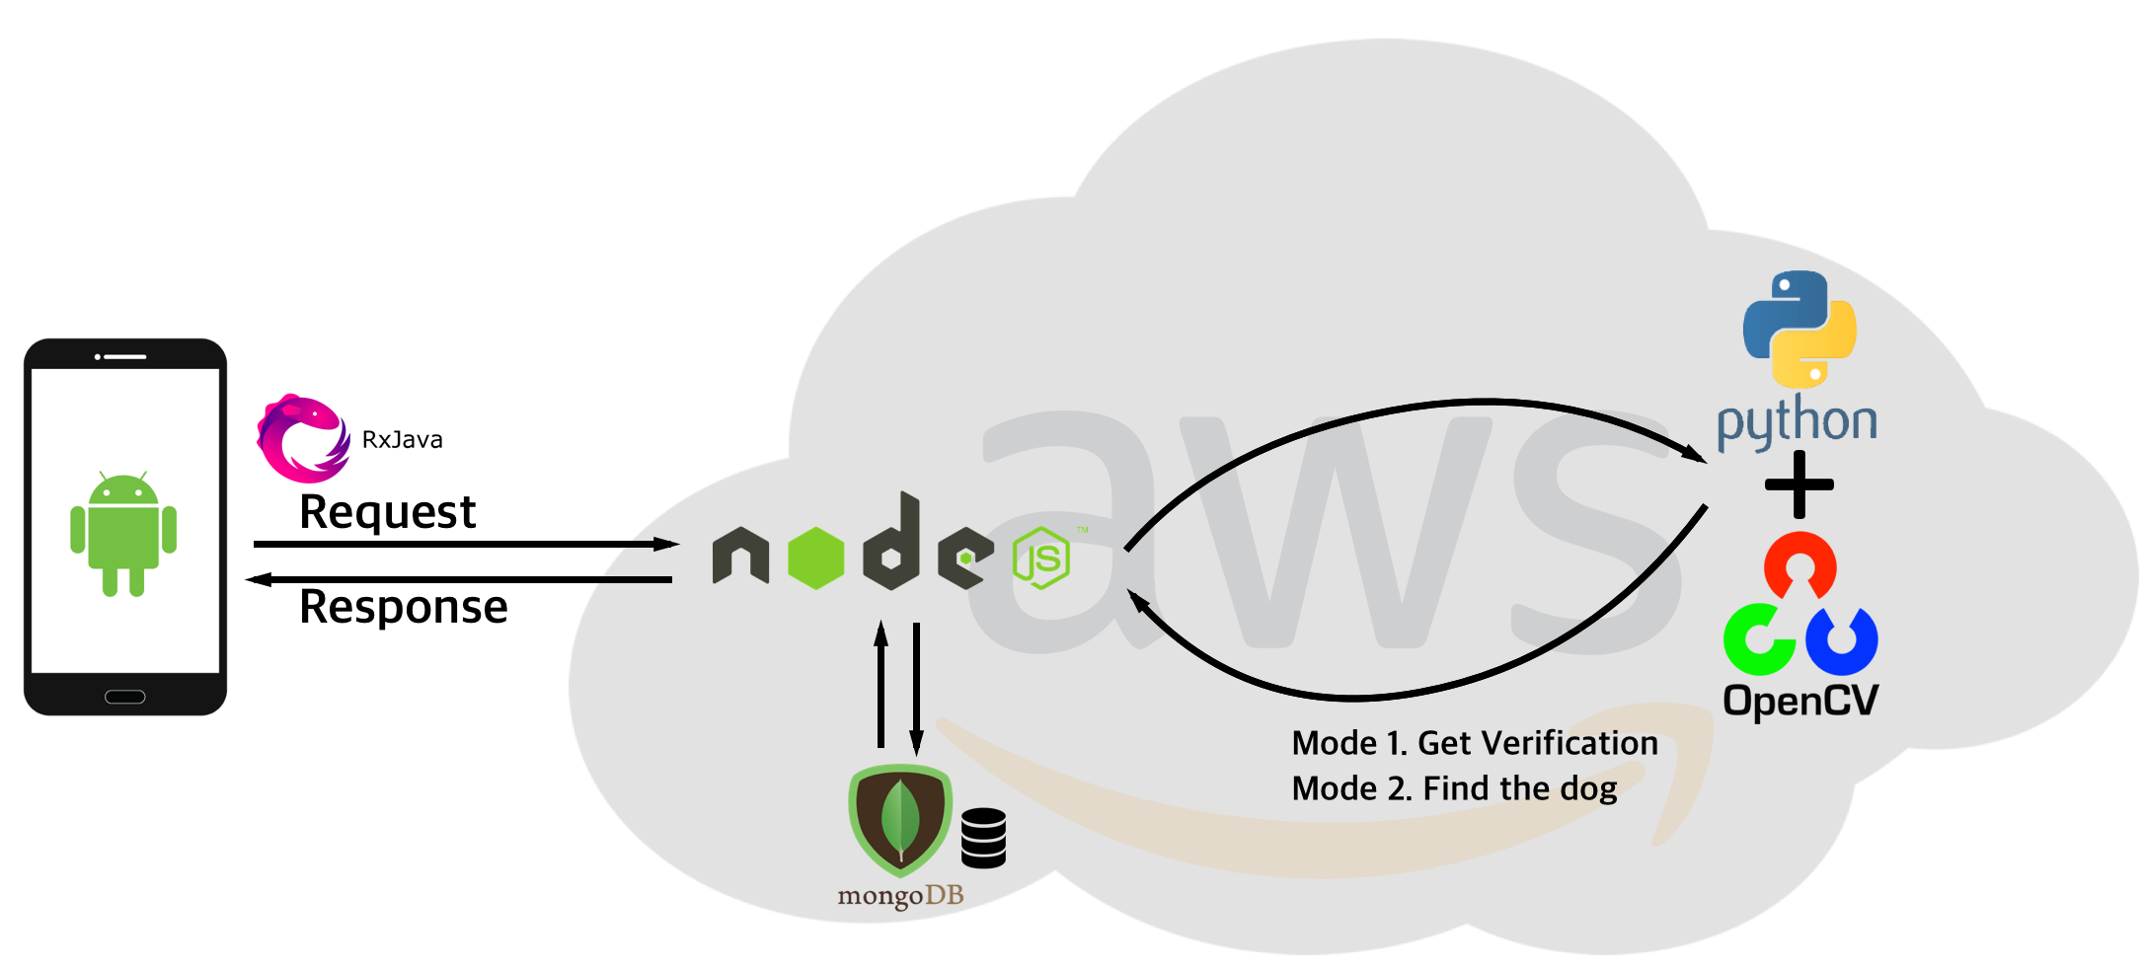
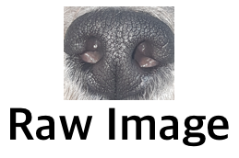
Project Flow Mode 0 : Registration
“Complete”
4
Notes:
This is the schedule later.

Slide 17
Project Flow Mode 1 : Verification
“True”
4
Notes:
This is the schedule later.

Slide 18
Project Flow Mode 2 : Identification
“Dog 2”
4
Notes:
This is the schedule later.

Slide 19
3. Development Progress

Slide 20
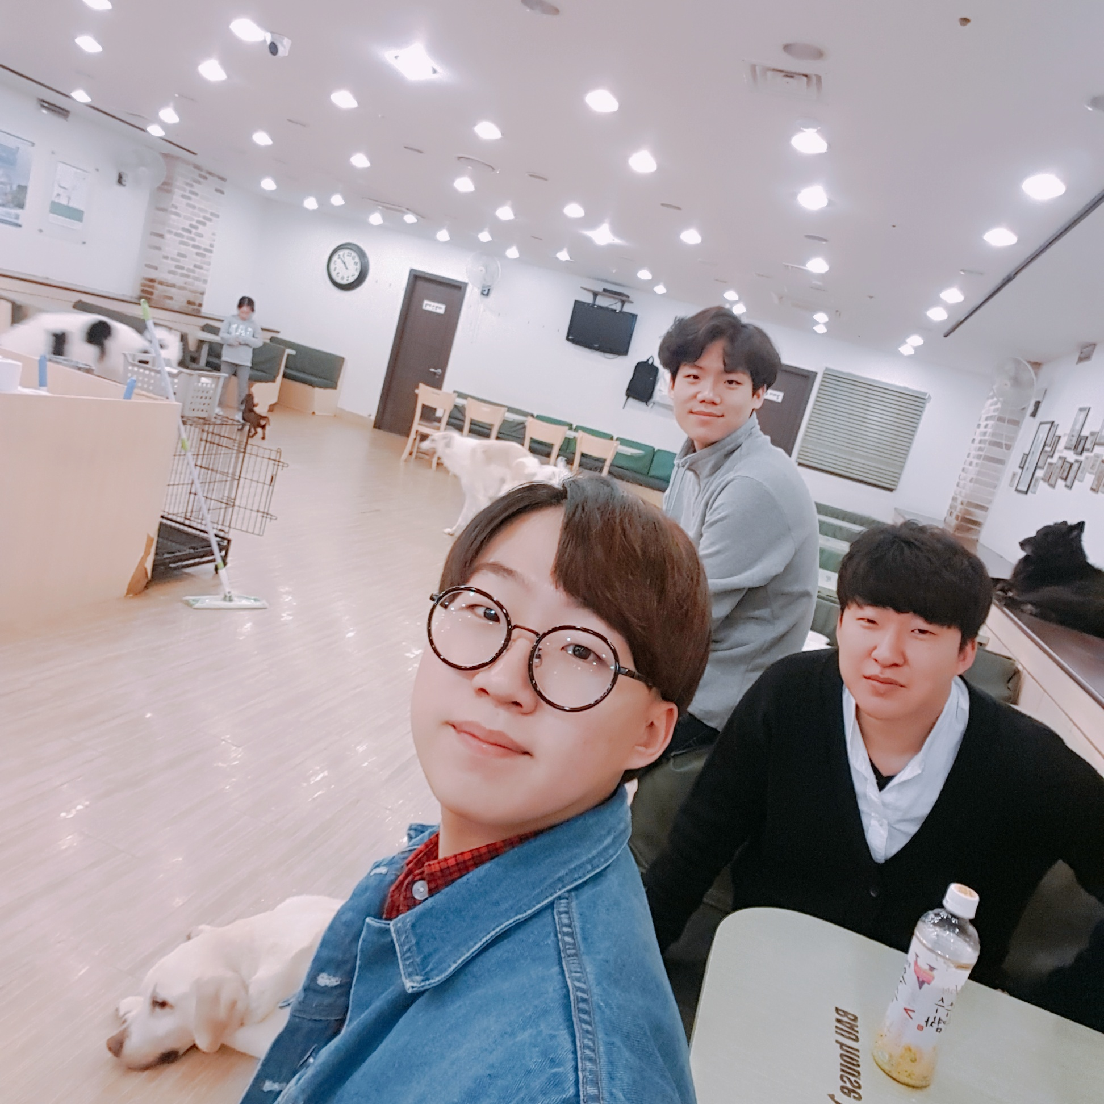
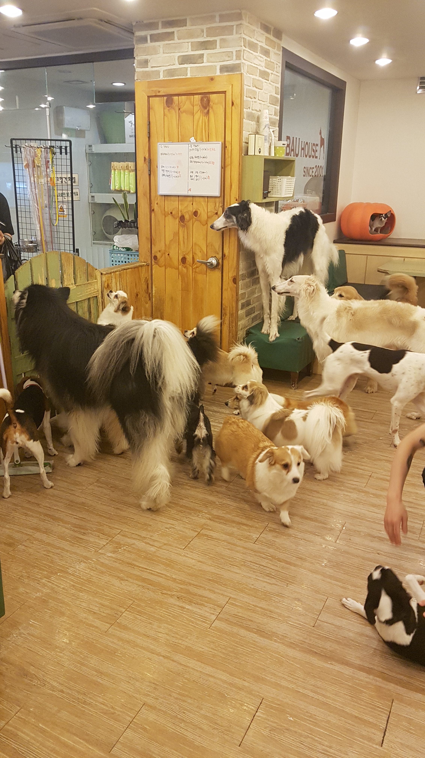
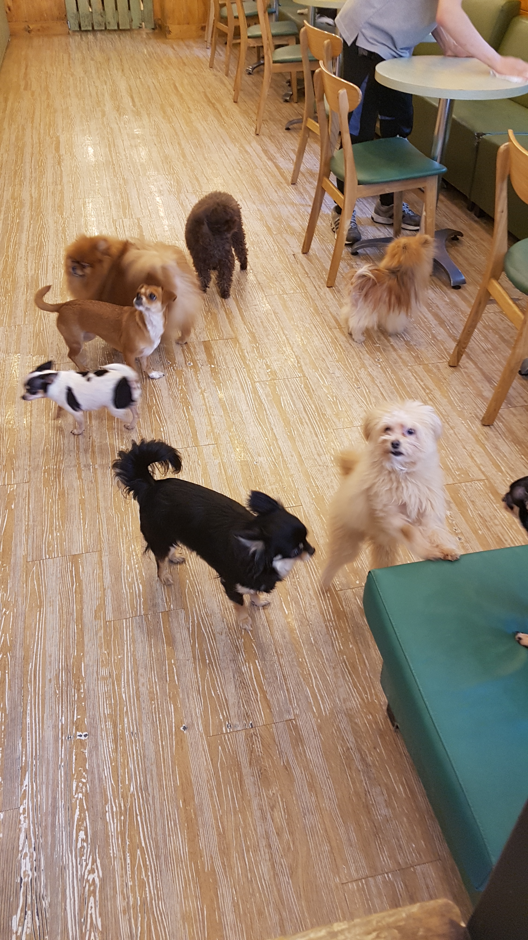
We visited dog cafe to collect some datas
4
Notes:
This is the schedule later.

Slide 21
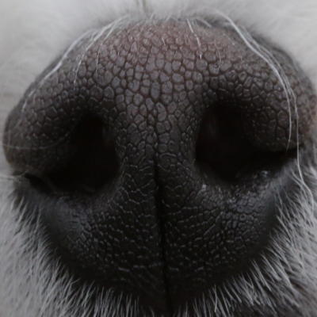
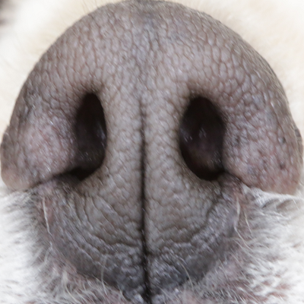
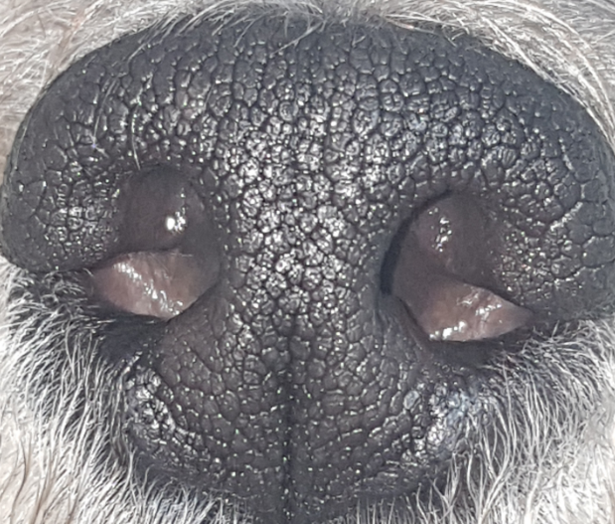
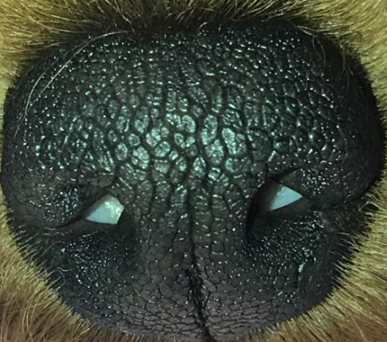
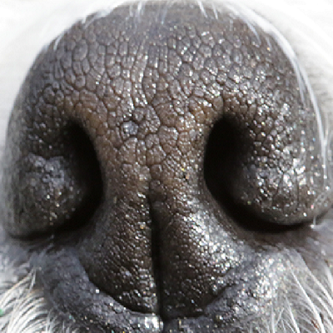
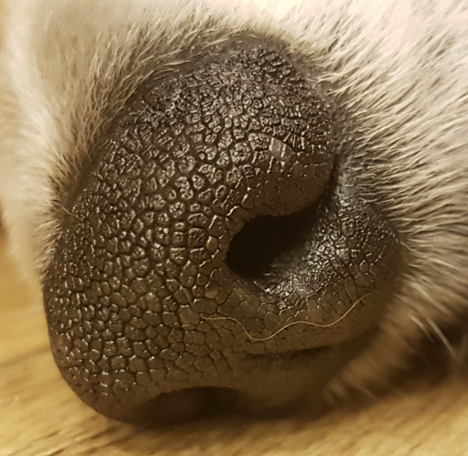
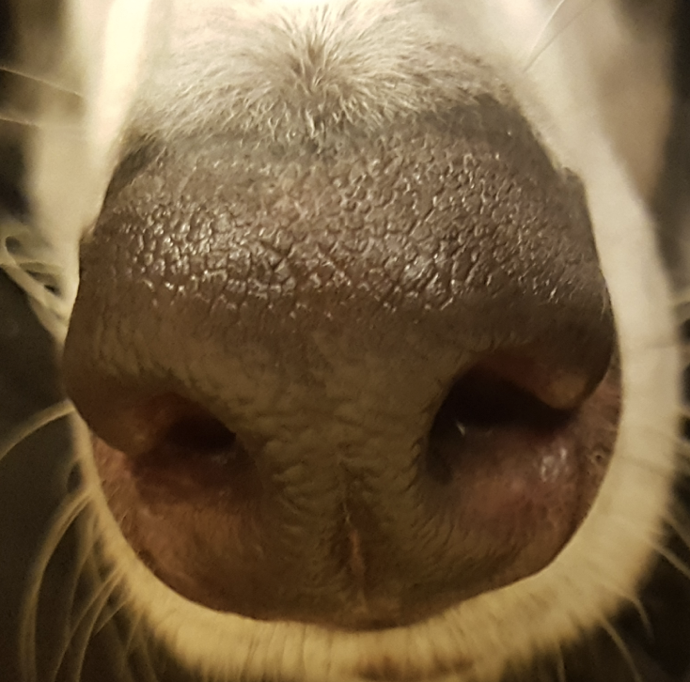
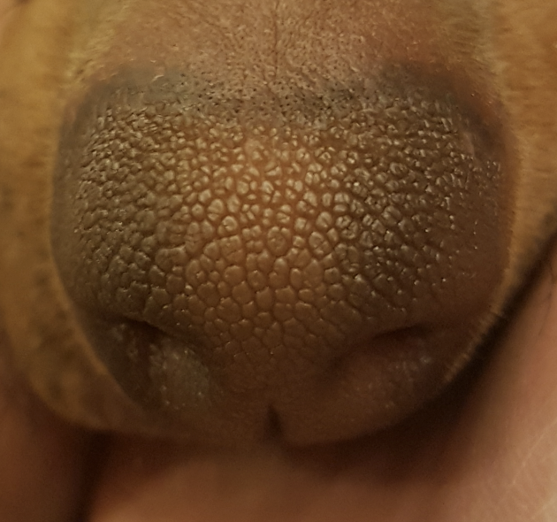
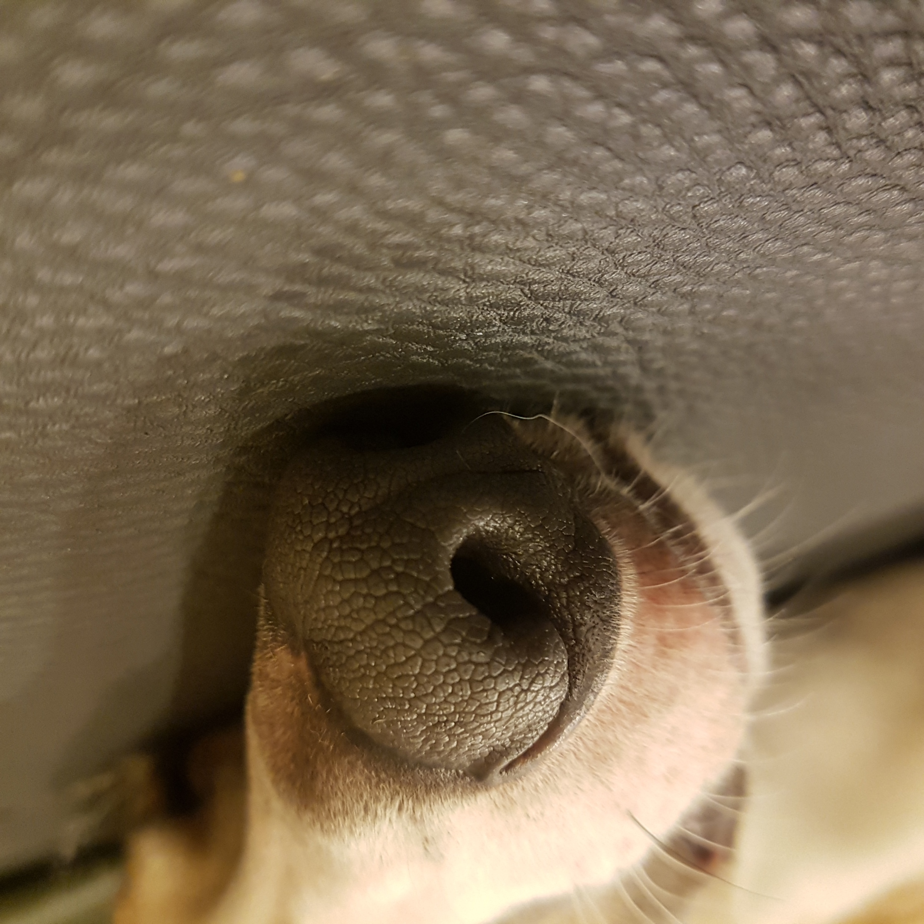
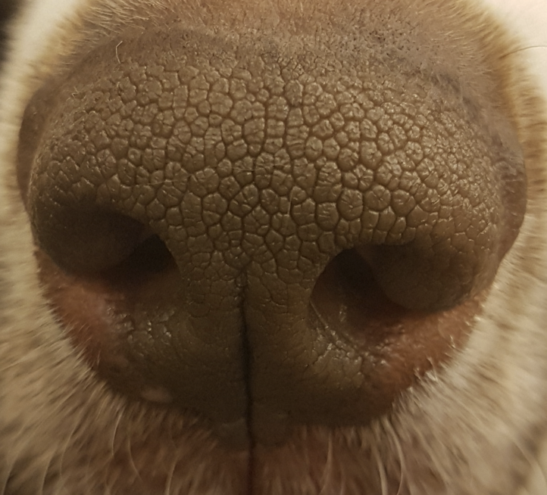
As a result, we collected some datas
10 kinds of dogs, 4~6 nose images per dogs, totally about 50 datas
(which is high resolution)
4
Notes:
This is the schedule later.

Slide 22
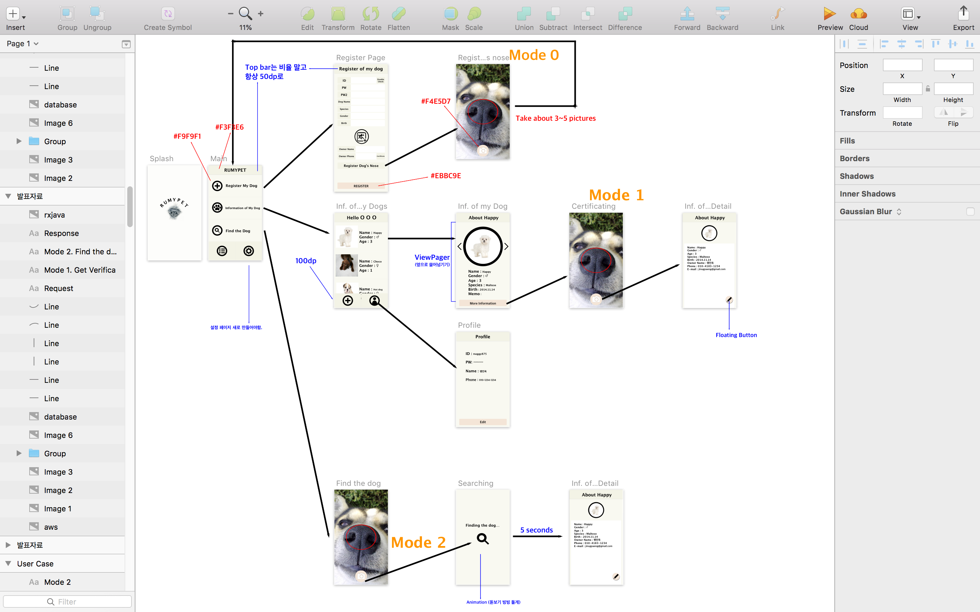

We used ‘Sketch’ for UI Design Tool
Sketch
4
Notes:
This is the schedule later.

Slide 23



Totally we used three programming languages
5

Slide 24




Editor we used in developing
5

Slide 25






Library and Framework we used
5

Slide 26
We Controlled the Version using GitHub
5

Slide 27
4. Execution Result

Slide 28


6

Slide 29
5. Future & Plan

Slide 30

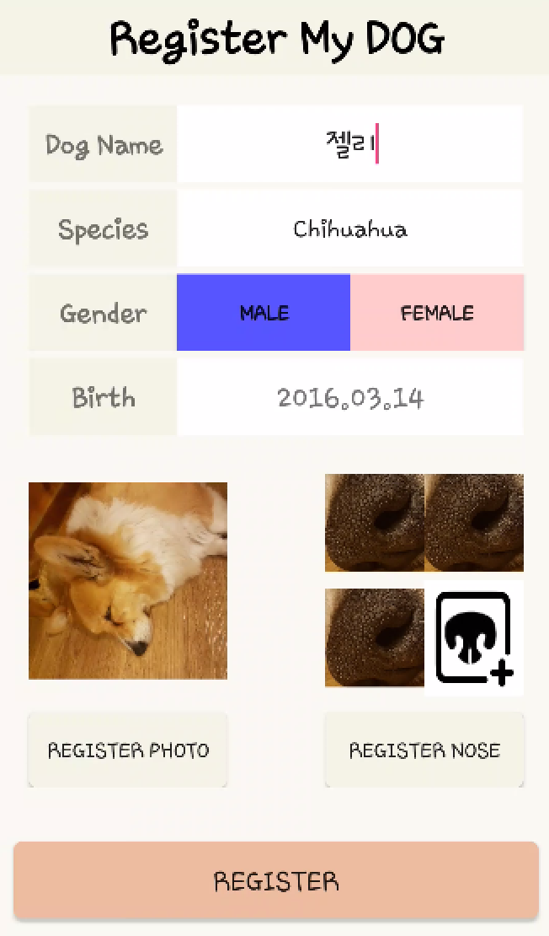

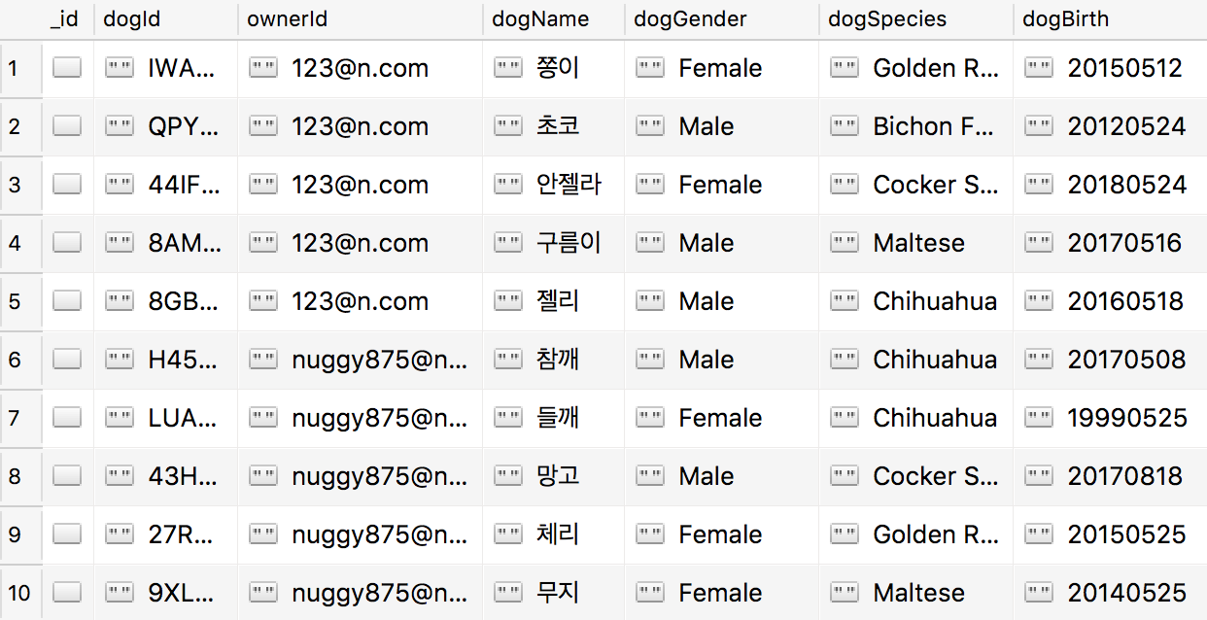
Schedule & Progress – Android & Server
“When user register the dog, the informations are saved in MongoDB”
7
Notes:
This is the UI Deisign we did last week.
Using this, Chan il Kim applied this into Android Studio.

Slide 31


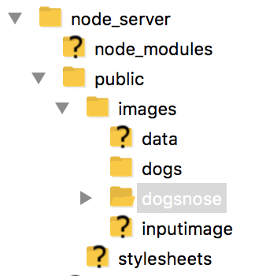
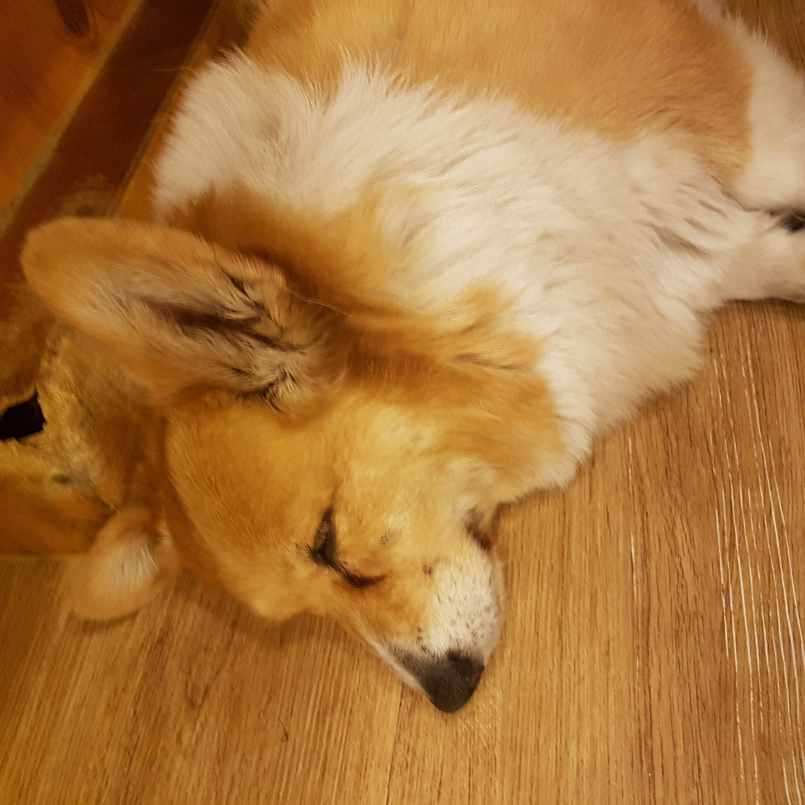
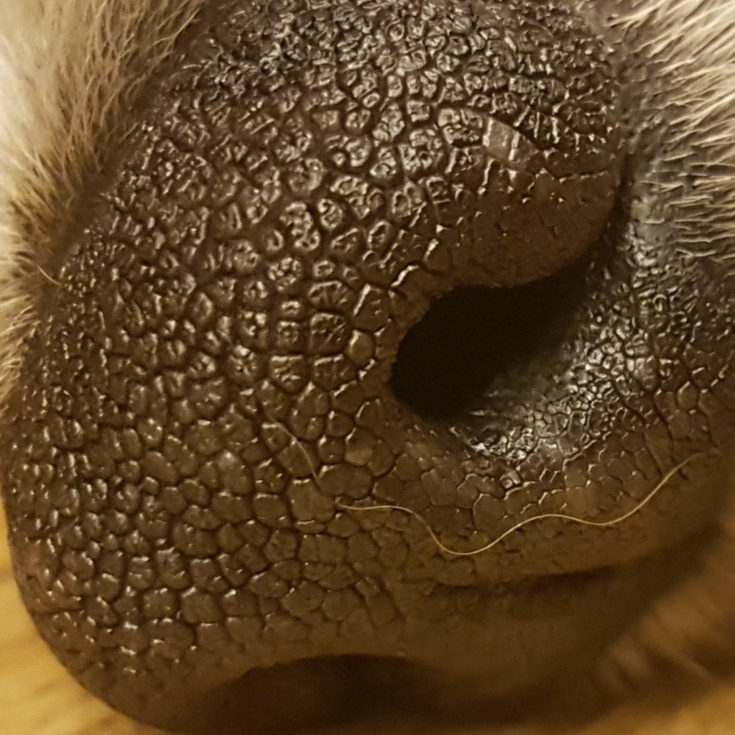
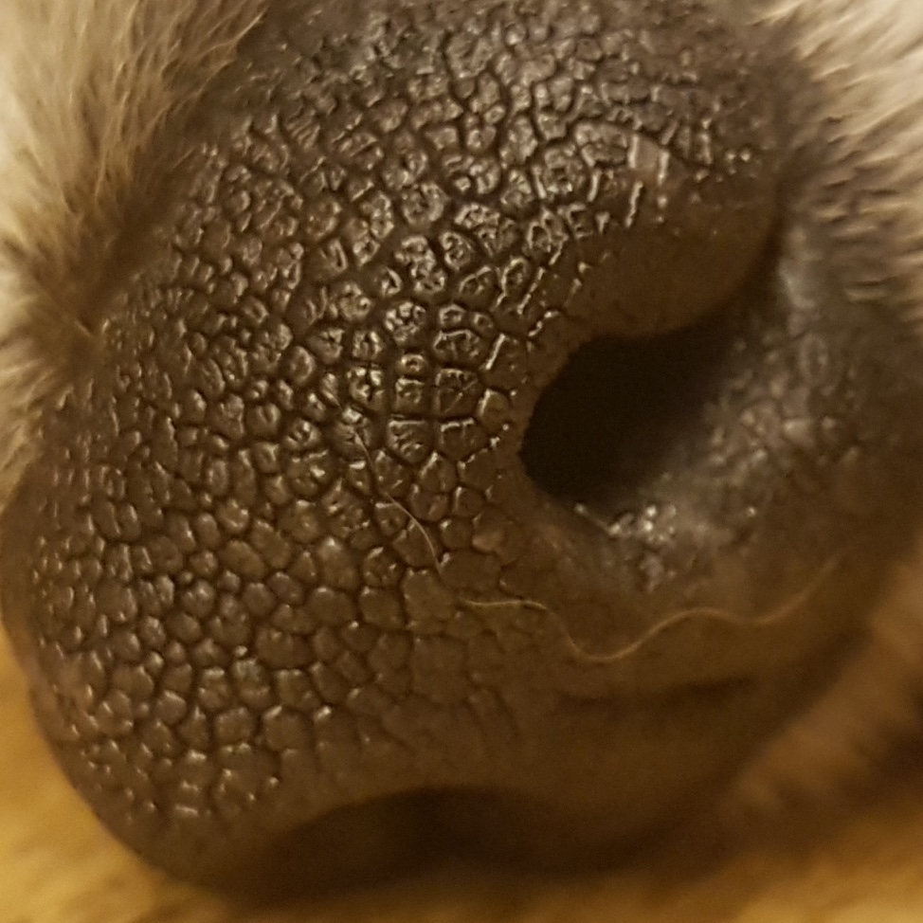
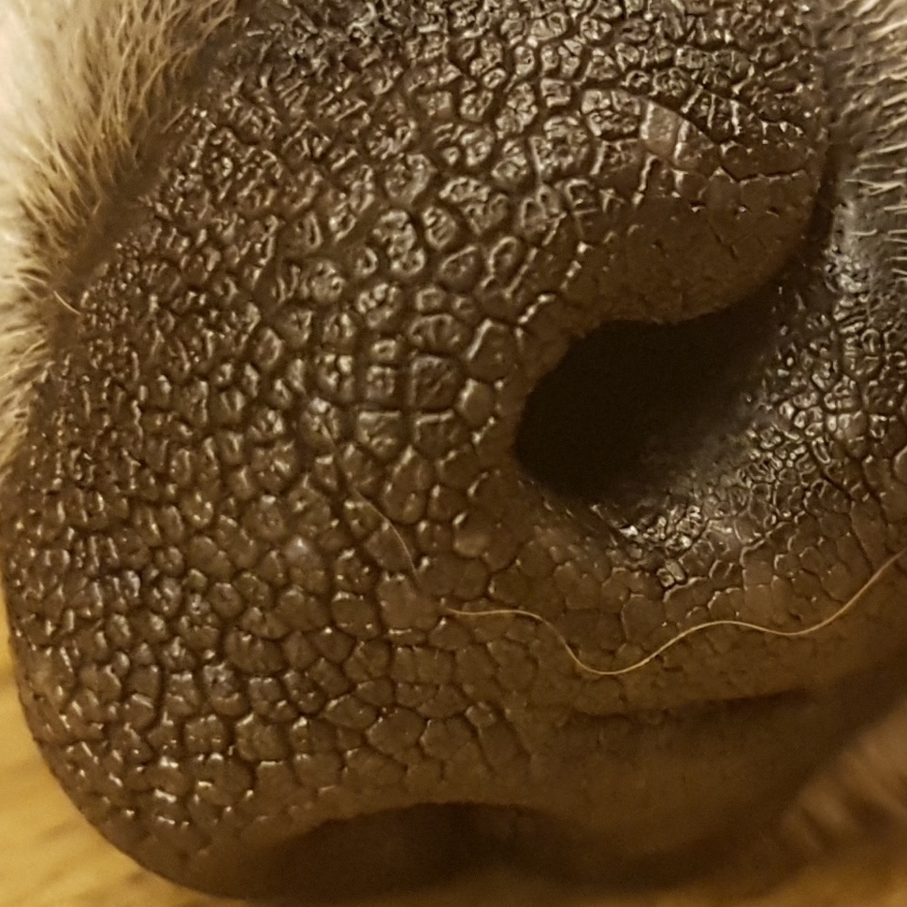
Schedule & Progress – Android & Server
“The images are saved in Local Storage of Server by Dog ID (random String)”
8
Notes:
This is the UI Deisign we did last week.
Using this, Chan il Kim applied this into Android Studio.

Slide 32
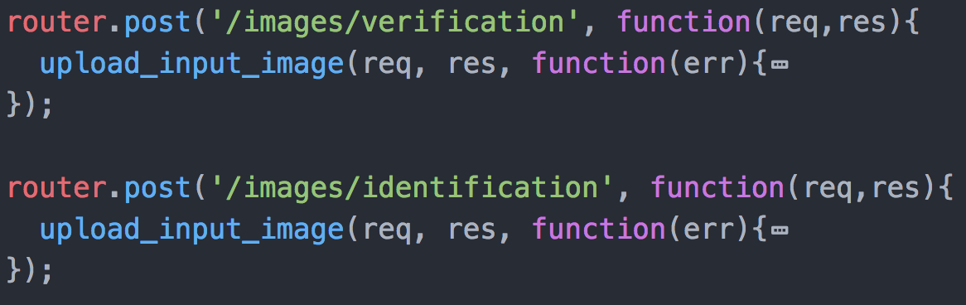
Schedule & Progress – Server
“Divide router for MODE 1(Verification) and MODE 2(Identification)”
9
Notes:
This is the UI Deisign we did last week.
Using this, Chan il Kim applied this into Android Studio.

Slide 33
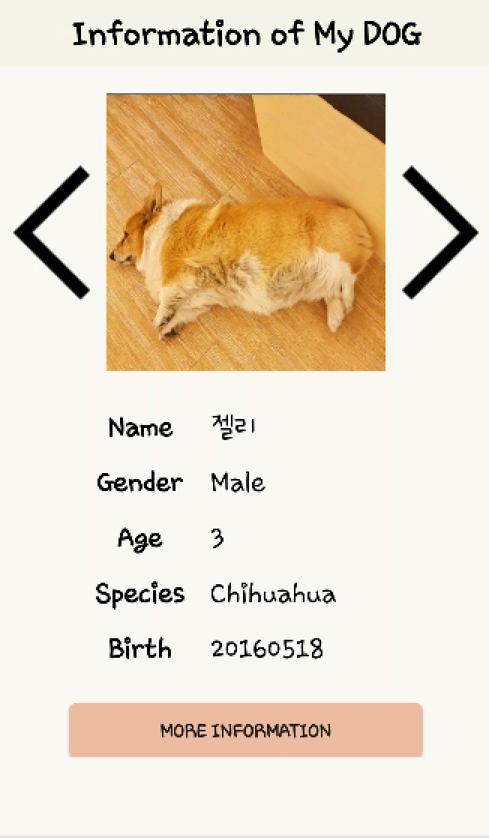

Schedule & Progress – Server (in mode 1)
“MODE 1 needs verification to get your dog’s private information”
Taking picture
“True” or ”False”
10
Notes:
This is the UI Deisign we did last week.
Using this, Chan il Kim applied this into Android Studio.

Slide 34
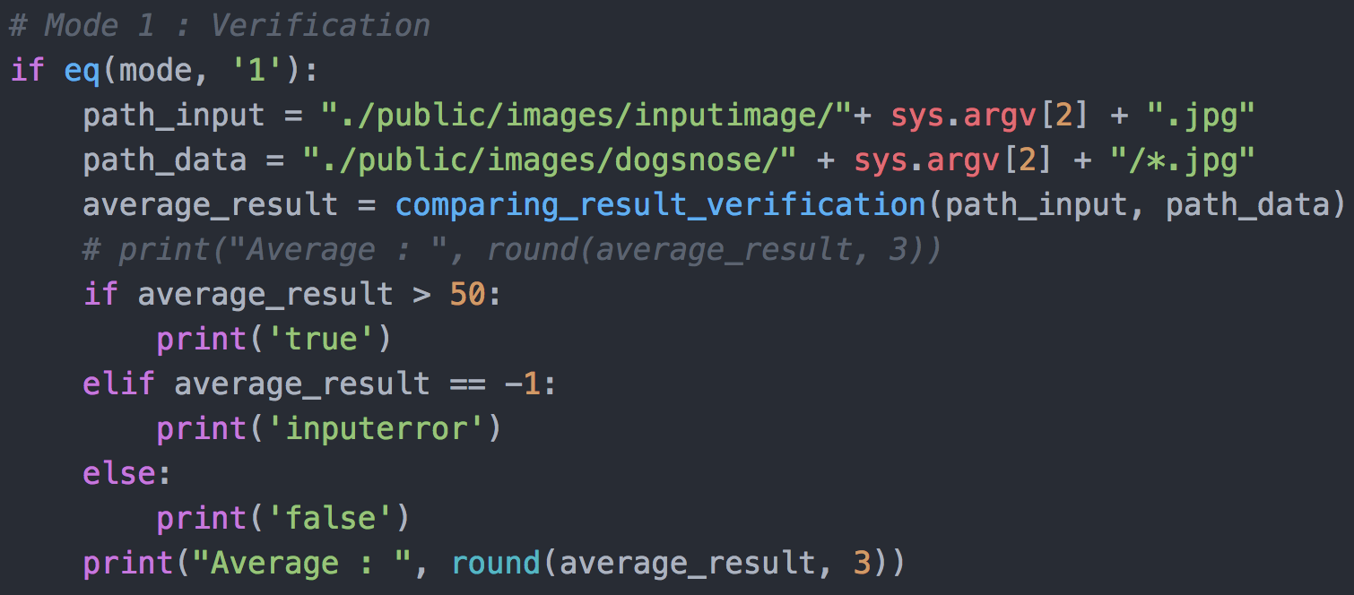
Schedule & Progress – Python (in mode 1)
“In Python for MODE 1, if the average of the result is over than 50,
it returns ‘True’, and if below, it returns ‘False’ ”
Input Image
“50 is based on many performance test”
11
Database
Notes:
This is the UI Deisign we did last week.
Using this, Chan il Kim applied this into Android Studio.

Slide 35
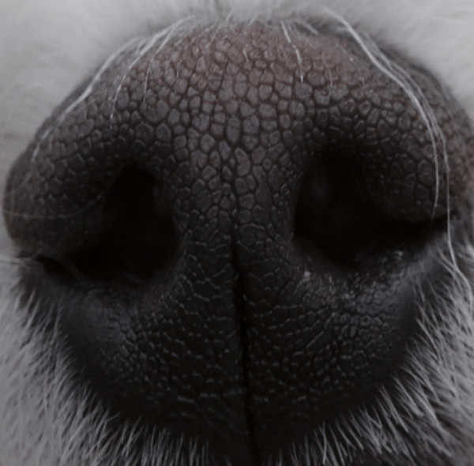
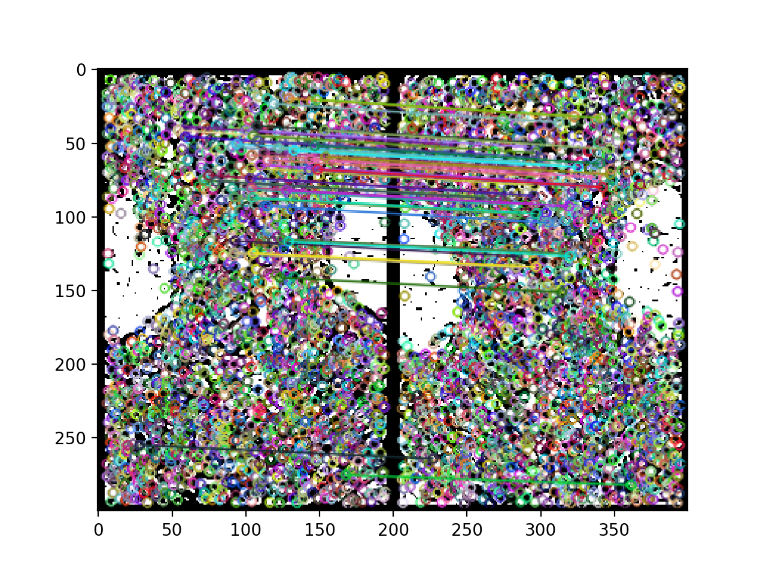
Schedule & Progress – Python (in mode 1)
“We used the Preprocessing method that we have developed.
But We didn’t have a progress in improving Feature matching Method (SIFT) ”
Pre-processing Method
Feature Matching Method
12
(SIFT)
Notes:
This is the UI Deisign we did last week.
Using this, Chan il Kim applied this into Android Studio.

Slide 36
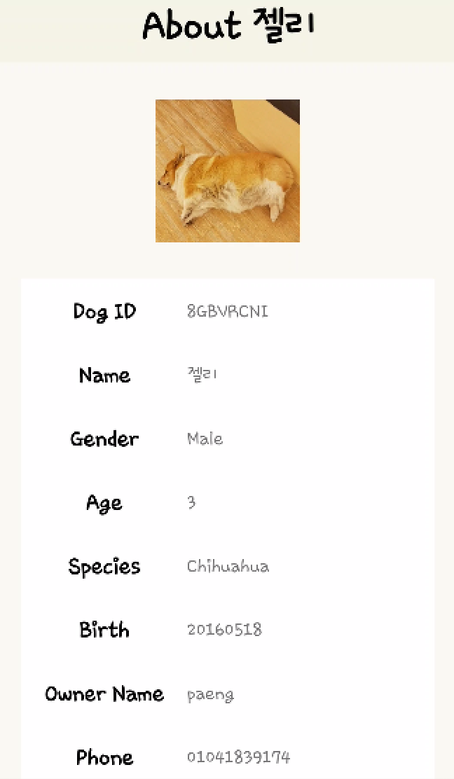
Schedule & Progress – Android (in mode 1)
“If TRUE, it will show you the dog’s private information in detail”
“True”
13
Notes:
This is the UI Deisign we did last week.
Using this, Chan il Kim applied this into Android Studio.

Slide 37
Schedule & Progress – Android (in mode 1)
“If FALSE, it will show you Nothing”
“False”
“Verification Failed”
14
Notes:
This is the UI Deisign we did last week.
Using this, Chan il Kim applied this into Android Studio.

Slide 38
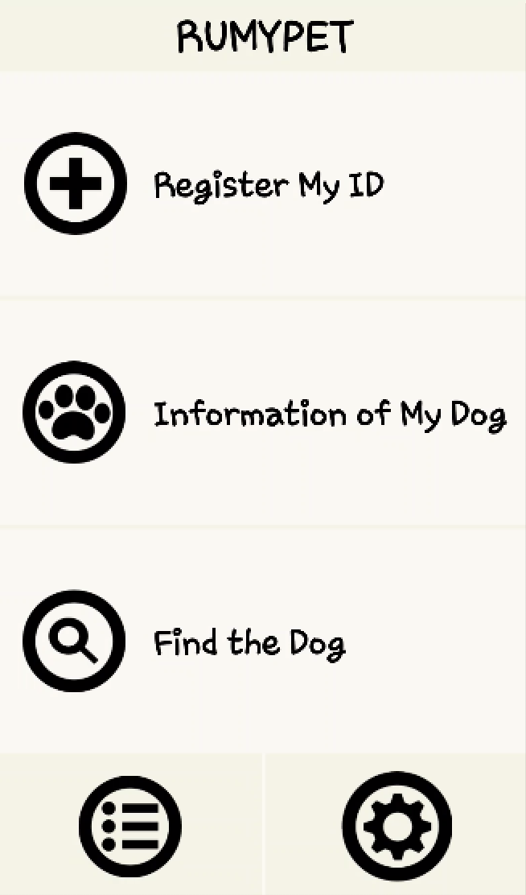
Schedule & Progress – Android (in mode 2)
“In our simple main page, you can get into the find the dog mode”
15
Notes:
This is the UI Deisign we did last week.
Using this, Chan il Kim applied this into Android Studio.

Slide 39
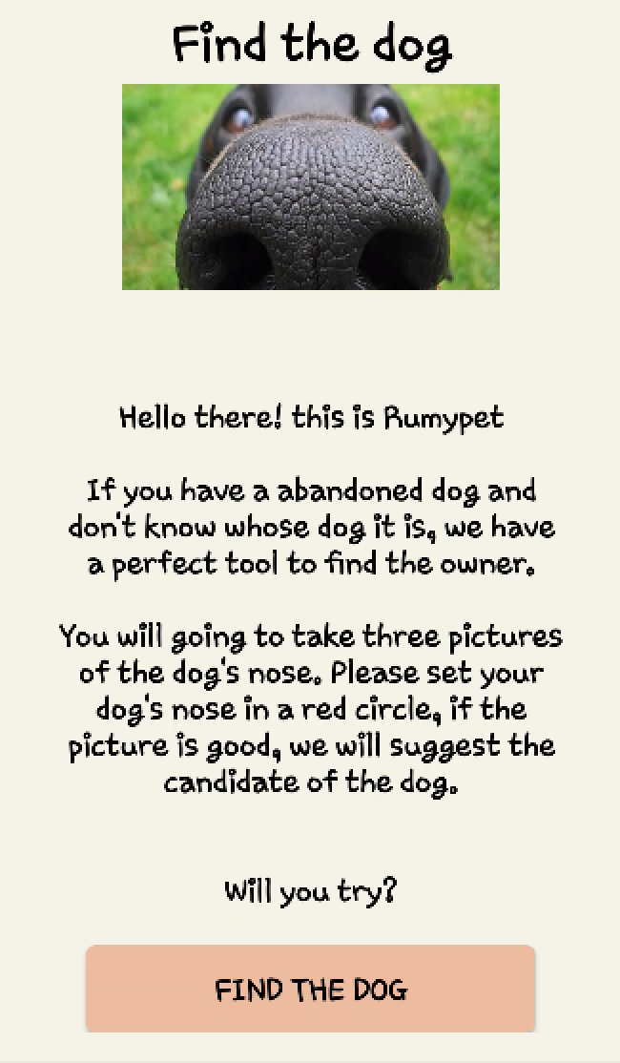
Schedule & Progress – Server (in mode 2)
“For MODE 2, we made a router of /identification”
Taking 3 pictures
”It is dog C”
16
Notes:
This is the UI Deisign we did last week.
Using this, Chan il Kim applied this into Android Studio.

Slide 40
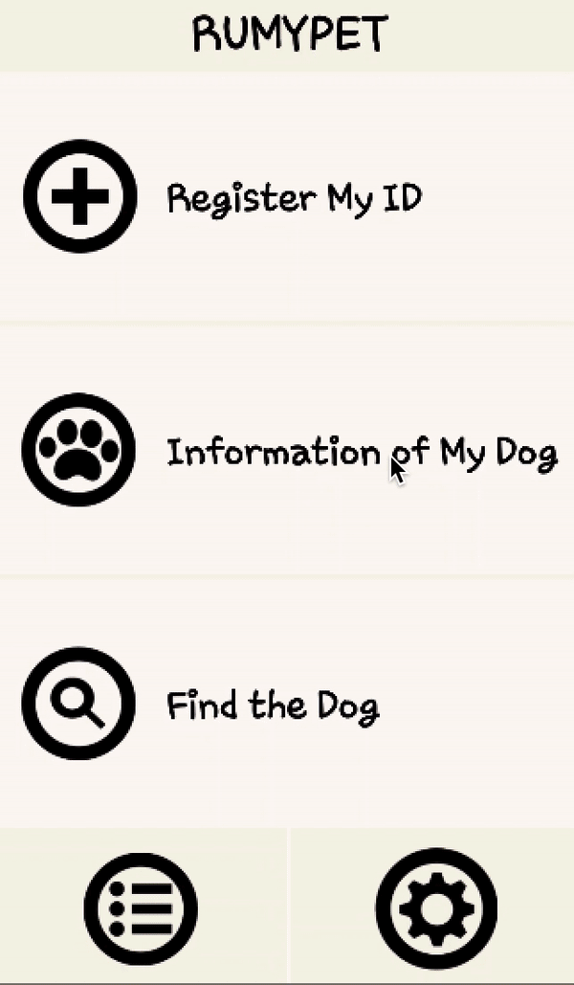
Schedule & Progress – Server (in mode 2)
“Let me show you the performing process”
17
Notes:
This is the UI Deisign we did last week.
Using this, Chan il Kim applied this into Android Studio.

Slide 41
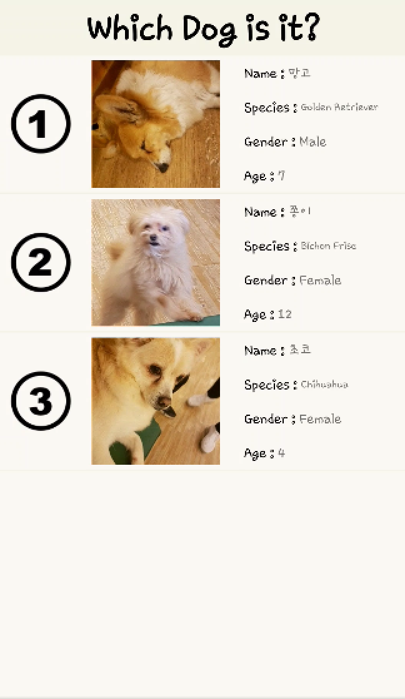
Schedule & Progress – Android (in mode 2)
“We made a candidate through the result score of the matching algorithm”
“You can click one of the list view to check the owner’s information”
18

Slide 42
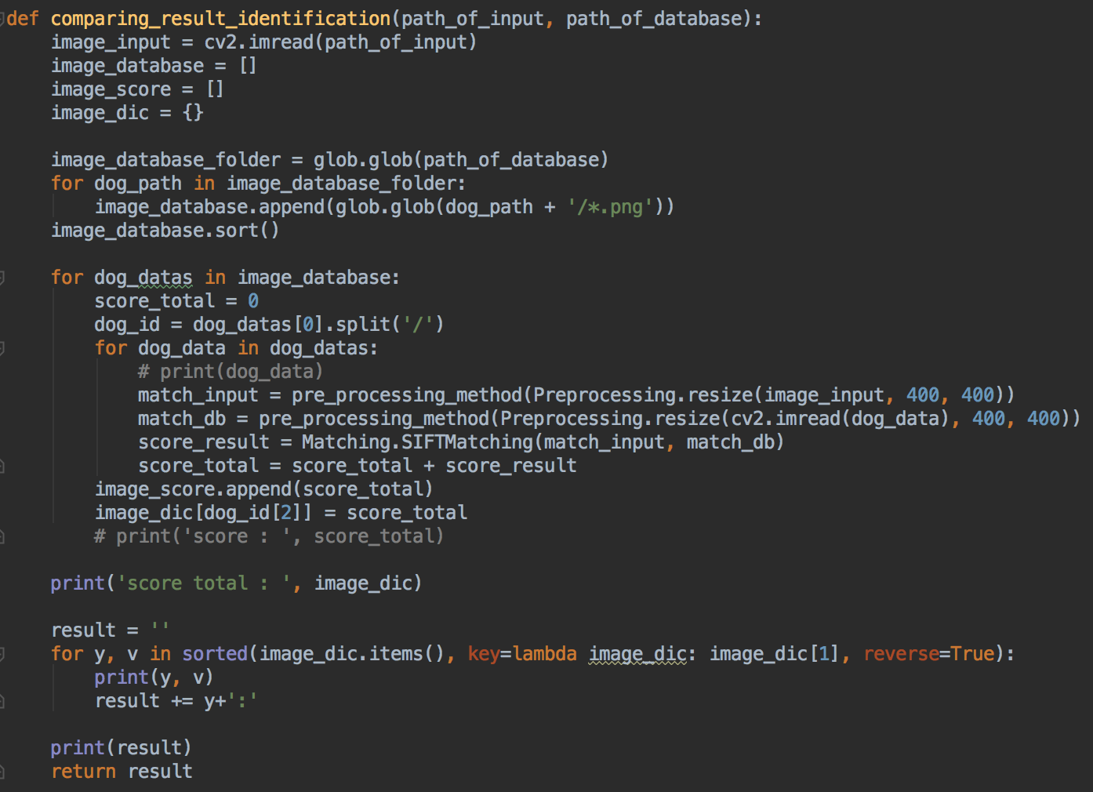
Schedule & Progress – Python (in mode 2)
“In Python for MODE 2, the function returns string data in order of the matching score”
Input Image
19
Database
Notes:
This is the UI Deisign we did last week.
Using this, Chan il Kim applied this into Android Studio.

Slide 43
2. PROBLEMS & SOLUTION

Slide 44

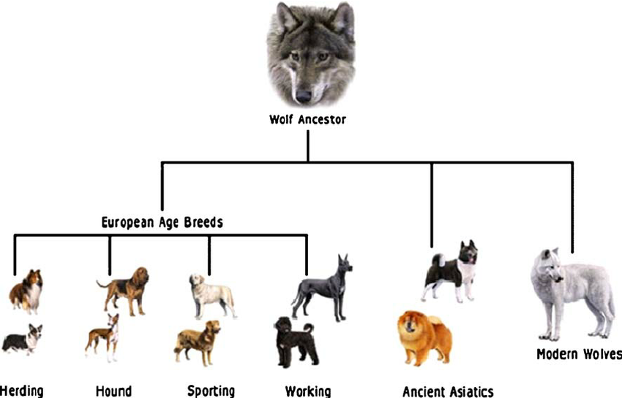
PROBLEMS & SOLUTIONS
Problem 1
Still, the process time is the problem... We don’t have that much data of the dog now in the database, but when it becomes commercialized, It should have some solutions.
Solution 1
Classification of the dog datas can help in some extent.
After, we should classify the dog datas
by species, colors or something else.
It could save much more time.
21
Notes:
--ppt reading--
Now, we have our own server!

Slide 45

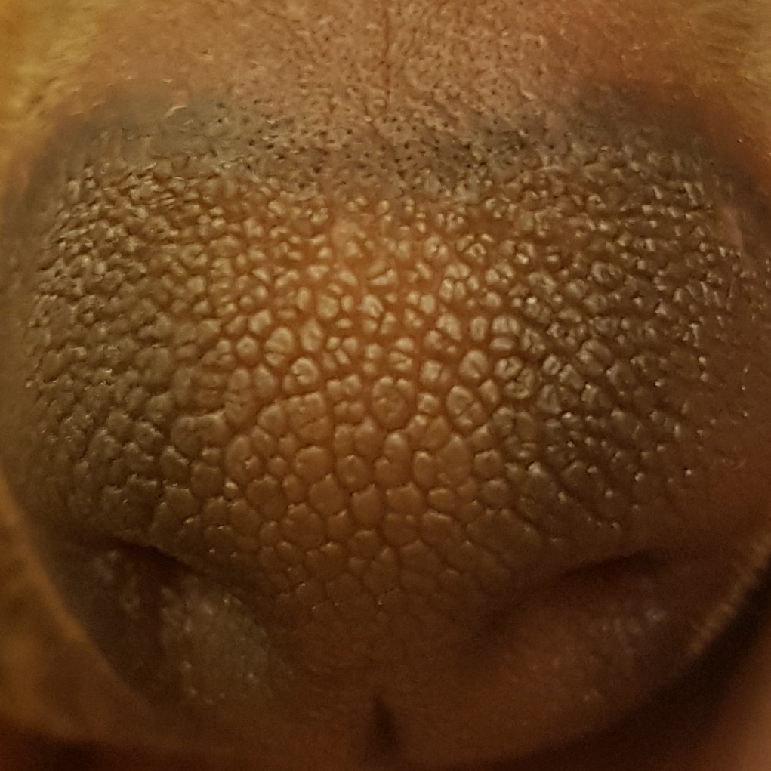

PROBLEMS & SOLUTIONS
Problem 2
We need more and more database for accuracy in testing
for pre-processing and feature matching algorithm.
But we have difficulty in collecting data...
Because the data should be a high resolution image.
It is rare...
Solution 2
To commercialize this project, we maybe should take some supports from the enterprise..
22
Notes:
--ppt reading--
Now, we have our own server!

Slide 46
3. PLANS

Slide 47
PLANS for next week
Week 14 | Final Demonstration
Notes:
ppt reading

Slide 48
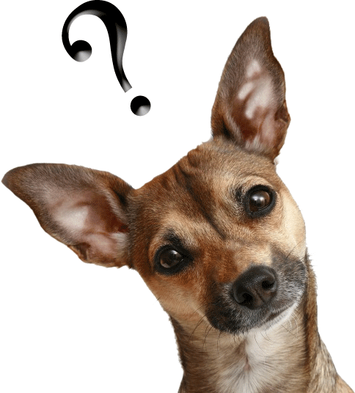

Q&A

Slide 49
Thank you!

